Slide 1
YANKEE DISTRICT JUDGE SCHOOL March 6, 2026 Point Scoring, Disqualifications & Penalization

Slide 2
DISQUALIFICATIONS vs. PENALTIES

Slide 3
DISQUALIFICATIONS vs. PENALTIES
DISQUALIFICATIONS
An exhibit must meet specific requirements to be eligible:
to enter the Show itself, AND
to enter any Class.
Failure to meet those requirements causes the exhibit to be DISQUALIFIED from being entered.
PENALTIES
When an exhibit has met the all requirements to be entered into both the Show, & into a Class, THEN it can be judged, and Penalized Proportionately for its Faults, imperfections, any other shortcomings.
IOW,
YOU are responsible for D/Q’s
- The ROSE is responsible for most PENALTIES

Slide 4
The only 7 Reasons for Disqualifying an Entry
1. A FOREIGN SUBSTANCE applied TO ENHANCE the beauty of the entry.
2. MISNAMED. An entry that is not the variety named on the entry tag.
This is different from “Improperly Named” (using an accepted synonym).
3. UNLABELED or Incompletely labeled.
(Entry lacks an entry tag, or the exhibitor’s name, and/or a class number,… ….. and/or the name of the variety is not given on the entry tag).
4. EXHIBITOR’S NAME VISIBLE, unless corrected before the entry is judged.
5. A CHALLENGE CLASS entry that does not satisfy the requirements of the
class in which it is entered.
6. Rose was not grown outdoors and/or NOT GROWN BY THE EXHIBITOR.
7. POSSIBLY: MORE THAN ONE ENTRY of the same variety in the same class by the same exhibitor, a Possible DQ unless it was relocated there by show staff, or is allowed by SHOW RULES
If it’s not here, IT’S NOT A DISQUALIFICATION !!!

Slide 5
RE. DISQUALIFICATIONS
Judges must never disqualify an entry unless they are very sure of the disqualification.
If there is any question about the certainty of an offense, a judge must never disqualify an entry.
If there is any doubt, perhaps just give a (big?) penalty, such as “un-typical” of variety.

Slide 6
VIOLATION OF SHOW RULES
Show rules establishing additional reasons for Disqualification are PROHIBITED.
SHOWS cannot invent additional D/Q’s
The only exceptions are below:
(1) rules that address the composition and staging of challenge classes and collections,
(2) rules concerning eligibility to enter a particular class,
(3) rules concerning absent exhibitors,
(4) rules concerning multiple exhibitors from the same garden, and
(5) rules concerning multiple entries of the same variety by the same exhibitor in the same class.

Slide 7
PENALTIES
There are numerous grounds to penalize a rose.
Primarily for faults in the 6 Prime Elements of Judging:
FORM
COLOR
SUBSTANCE
STEM & FOLIAGE
BALANCE & PROPORTION
SIZE

Slide 8
In addition to Penalties on the physical horticultural excellence based on how well it was grown, there are a few Penalties that can be caused by how it was presented due to the Exhibitor’s Poor Grooming choices, practices, skill, & timing, such as:
Dis-budding too late
Leaf damage
Petallage & Petaloids
- Bird lime if not removed
- Stem on stem

Slide 9
Judging “SIZE” for Min-Floras
In 2024, ARS made a change to judging “Size” for Min-Floras
MINIFLORA judging criteria for SIZE is now aligned with MINIATURE roses:
Size of bloom criteria is NOW “Typical of the Variety.”
“Bigger is Better” is NO LONGER true.”
Now, bigger & smaller are to be penalized as “not typical of the variety.”
This is the only group that this change applies to.

Slide 10
FORMER D/Q’s which have been REDUCED or ABOLISHED – I for the “Old-Timers”
1. NOT DISBUDDED / side buds when required by the Show,
are NOW a Potential penalty, depending on degree of
distraction
2. STEM-ON-STEM in those classes where it had been a D/Q:
In classes where previously not allowed above the vase,
Stem-on-Stem is NOW a Potential PENALTY;
In classes where previously not allowed below the vase,
Stem-on-Stem is NOW ABOLISHED.
3. MISPLACED – staff/exhibitor must correct before being judged

Slide 11
FORMER D/Q’s which have been REDUCED or ABOLISHED - II
4. MISCLASSED – staff/exhibitor must correct before judging
5. IMPROPERLY NAMED – staff/exhibitor must correct before being judged
NOTE: Misspellings, Abbreviations, Bad Grammar
Are NOT Penalties or a DQ
6. VIOLATION OF SHOW RULES - ABOLISHED,
EXCEPT for Collections & Challenges
NOTE: Shows NOW MAY allow an exhibitor to enter MORE THAN ONE SPECIMEN of the SAME VARIETY in the SAME CLASS.
I.O.W. FOR STANDARD ARS CLASSES,
Local Societies cannot invent their own rules.

Slide 12
RAMBLERS
Ramblers have seen a lot of changes.
In the 2018 edition of the Guidelines, ARS announced that “The Rambler class has been eliminated. Most Ramblers have been reclassified to” (either the OGR’s as a) “hybrid multiflora, or as a hybrid wichurana” & so remained in the Climbers.
The 2021 edition announced that the Rambler Class was back, and that the “Ramblers (R) are exhibited in the climber class.”

Slide 13
BUT…. ARS did not clarify if all, or only some, of those hyb. Multiflora & Wichuraiana had been returned to Rambler status, or if some remained as OGR’s.
Apparently, the Breeders’ record keeping was poor, & the genetics are mixed.
So, it is always a good idea to download the latest copy of the Guidelines from the ARS at ROSE.ORG, and ALSO the latest Buying Guide Handbook.

Slide 14
POINT SCORING
JUDGING IS A TEST OF OUR ABILITY TO FIND THE BEST ROSE,
NOT OF OUR ABILITY TO FIND FLAWS

Slide 15
We are Not judging to find which rose strikes us as the “prettiest”
A Judge’s job is to determine which specimen of each variety comes closest to the standard of Perfect Beauty for its own variety.
ARS has created a “SCIENTIFIC” SYSTEM for evaluating “Beauty” Rationally & Objectively, rather than based on personal preference.
This system is called “POINT SCORING.”

Slide 16
POINT SCORING
It starts out assigning the maximum value of 100 points to each entry.
Then it is Judged, based on how close it comes to the full 100 points of its variety’s standard of perfection
“BEAUTY” must be graded in accordance with the ARS’ “scientific” standards of Point Scoring each rose, as set forth in the ARS Guidelines

Slide 17
WHERE DO 100 POINTS COME FROM ? SCORE CARD – Generic (IN MOST CASES)
They’re based on the 6 PRIME ELEMENTS of a Rose
FORM (shape) of the BLOOM – 25 Points
COLOR of the BLOOM — 20 Points
SUBSTANCE of the BLOOM — 15 points
STEM and FOLIAGE — 20 points
BALANCE and PROPORTION —10 Points
SIZE of the BLOOM — 10 Points
--------------------------
100 Points

Slide 18
Score Card for SEEDLINGS and SPORTS
ORIGINALITY......................................................... 20
FORM........................................................................ 20
COLOR....................................................................... 20
SUBSTANCE............................................................... 20
STEM AND FOLIAGE.................................................. 10
BALANCE AND PROPORTION...................................... 5
SIZE............................................................................. 5
TOTAL..................................................................... 100 Points
Seedlings and sports can be of any rose type and should be judged by the standards of that type.
However, originality of the characteristics of the variety is given extra consideration in the point scoring of the specimen. Originality or novelty represents beauty that is different from other roses in commerce.
Originality should not represent something strange or ugly.

Slide 19
POINT SCORING CHALLENGES & COLLECTIONS
IN CHALLENGE CLASSES, PLACEMENT OF THE SPECIMENS IS PART OF THE EVALUATION.
The judge must not only judge each specimen on its own merit,
the judge must also evaluate the overall appearance of the whole exhibit.
Therefore, NEVER TOUCH A CHALLENGE EXHIBIT BEFORE IT IS JUDGED.
SCORE CARD FOR JUDGING CHALLENGE CLASSES
Challenge classes are judged using the following scorecard:
Horticultural Excellence of the Individual Specimens................. 80
Overall Appearance of the Exhibit.............................................. 20
Total 100 Points

Slide 20
Score Card for Judging CHALLENGE Classes
(Not Collection Classes)
Challenge classes are judged using the following scorecard:
Horticultural Excellence of the Individual Specimens...... 80
Overall Appearance of the Exhibit................................... 20
100 Points
More on these later.

Slide 21
DEFINING THE 6 PRIME ELEMENTS
In the Guidelines, the Prime Elements are defined somewhat differently in different groups.
i.e. “Form” is defined differently for
HT’s, Sprays, OGR’s, Shrubs, etc.
“Substance” differs with OGR’s
And so on.

Slide 22
HOW DOES A ROSE LOSE POINTS ?
All specimens start out with 100 points
BUT, no rose is flawless.
Judges deduct “Penalty” Points from a rose for its flaws in the 6 Prime Elements of a Rose, (Form, Color, Substance, etc.)
The degree of the penalty depends on the Degree of Impairment or “How Distracting” the flaw is from the overall beauty of the rose.

Slide 23
All Faults Are NOT Penalized Equally
There is not just one standard penalty for each fault (i.e. a fault in Form costs 1 point).
A rose could lose up to 25 points for bad Form
(if it were a moldy, dead, bloom with a lone shriveled petal dangling by a thread).

Slide 24
ALL ELEMENTS ARE EQUAL, (SORT OF)
GENERALLY speaking:
WHERE a rose loses points is not important.
TOTAL points lost IS important
UNLESS
It comes down to choosing between 2 equally scored exhibits, where
- one scored heavily in Form, Color, & Substance, &
- the other scored heavily in the other 3 elements,
the better BLOOM wins. (It IS a ROSE Show !! )
This is unlikely, but an important concept.

Slide 25
BE CONSISTENT !
For example, when Balloting for Queen, if one variety naturally produces smaller average blooms, and the other variety naturally produces larger average blooms, and both specimens are displaying their “typical” sized blooms
you should give both of them the same “average” score for size, even though one is larger than the other.
Do NOT give a naturally larger bloom a better score for size, just because it naturally grows bigger.

Slide 26
GENERAL RULE
In a team of judges, one judge may point score like a spendthrift, while the other may point score like a miser.
But, if they both score consistently, their final standings should agree.

Slide 27
HOW WE “POINT SCORE”

Slide 28
FORM of the BLOOM 25pts
Form refers to the SHAPE of the bloom, the degree of OPENNESS of the bloom, and its SYMMETRY (Lop-sided is bad).
The most beautiful form varies from variety to variety, & from group to group.
Some are most beautiful when at the HT “Exhibition Form” stage, while others at the Open Bloom Stage.
Some have unique forms, like OGR’s.

Slide 29
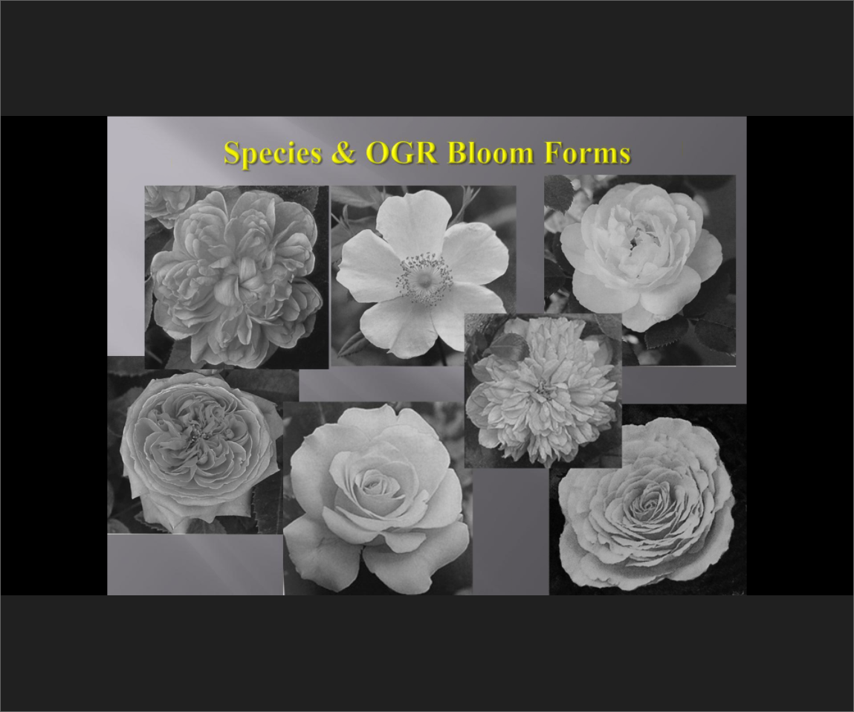
SOME ASSORTED FORMS

Slide 30
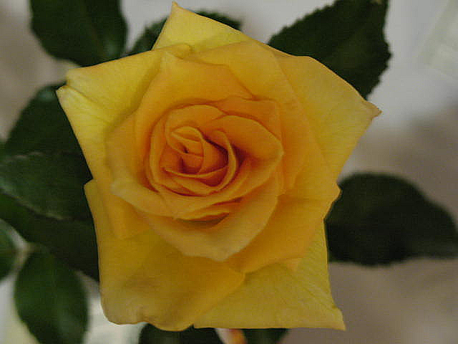
POOR CENTER

Slide 31
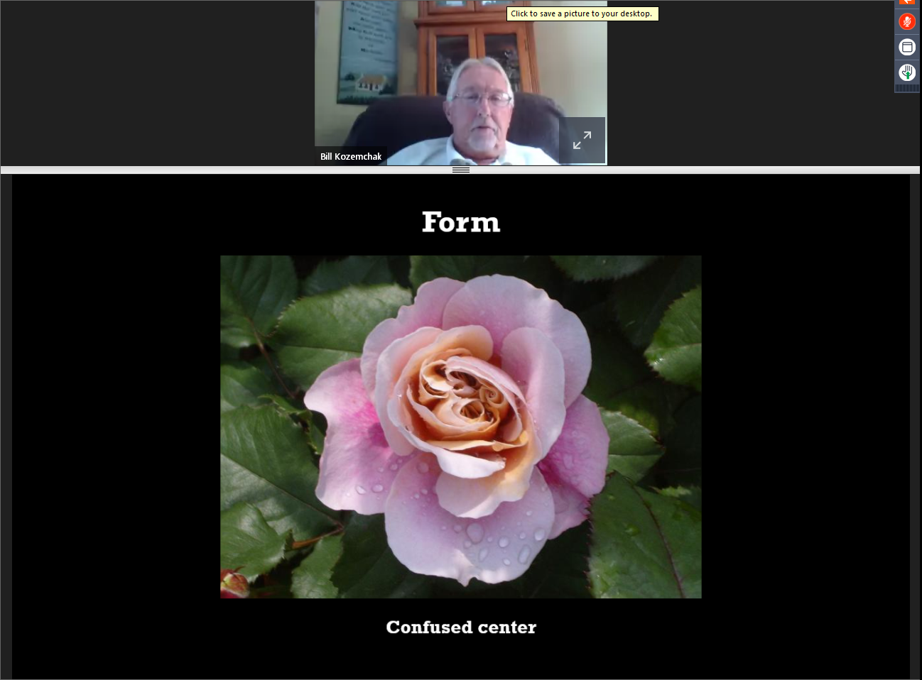
From Bill Kozemchak's webinar

Slide 32
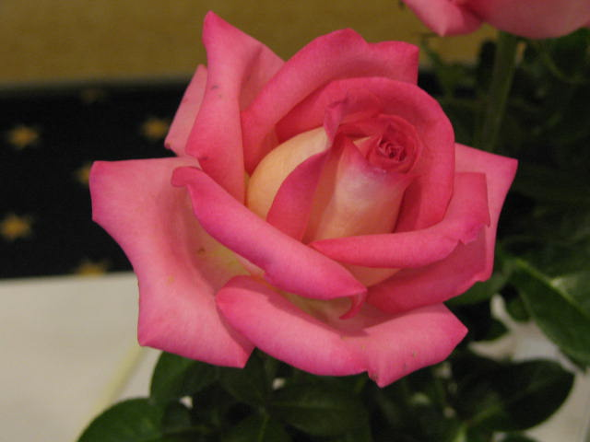
FORM – High Spiral Center “Exhibition Form”

Slide 33
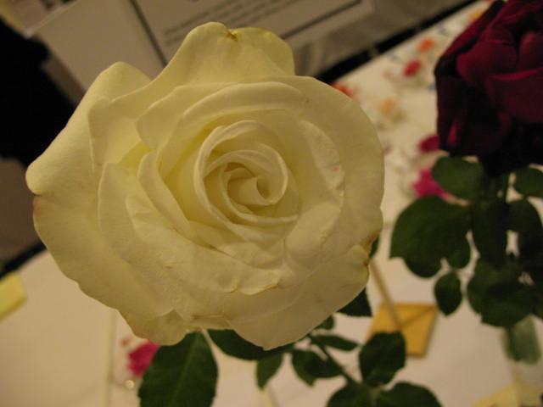
Passing Exhibition Stage

Slide 34
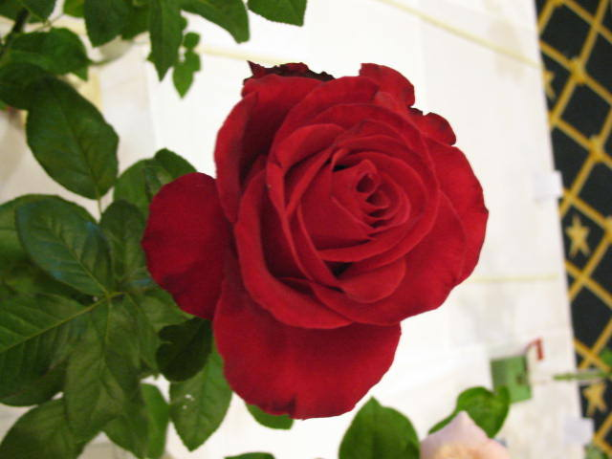
FORM – Poor Center; not Circular = Penalties

Slide 35
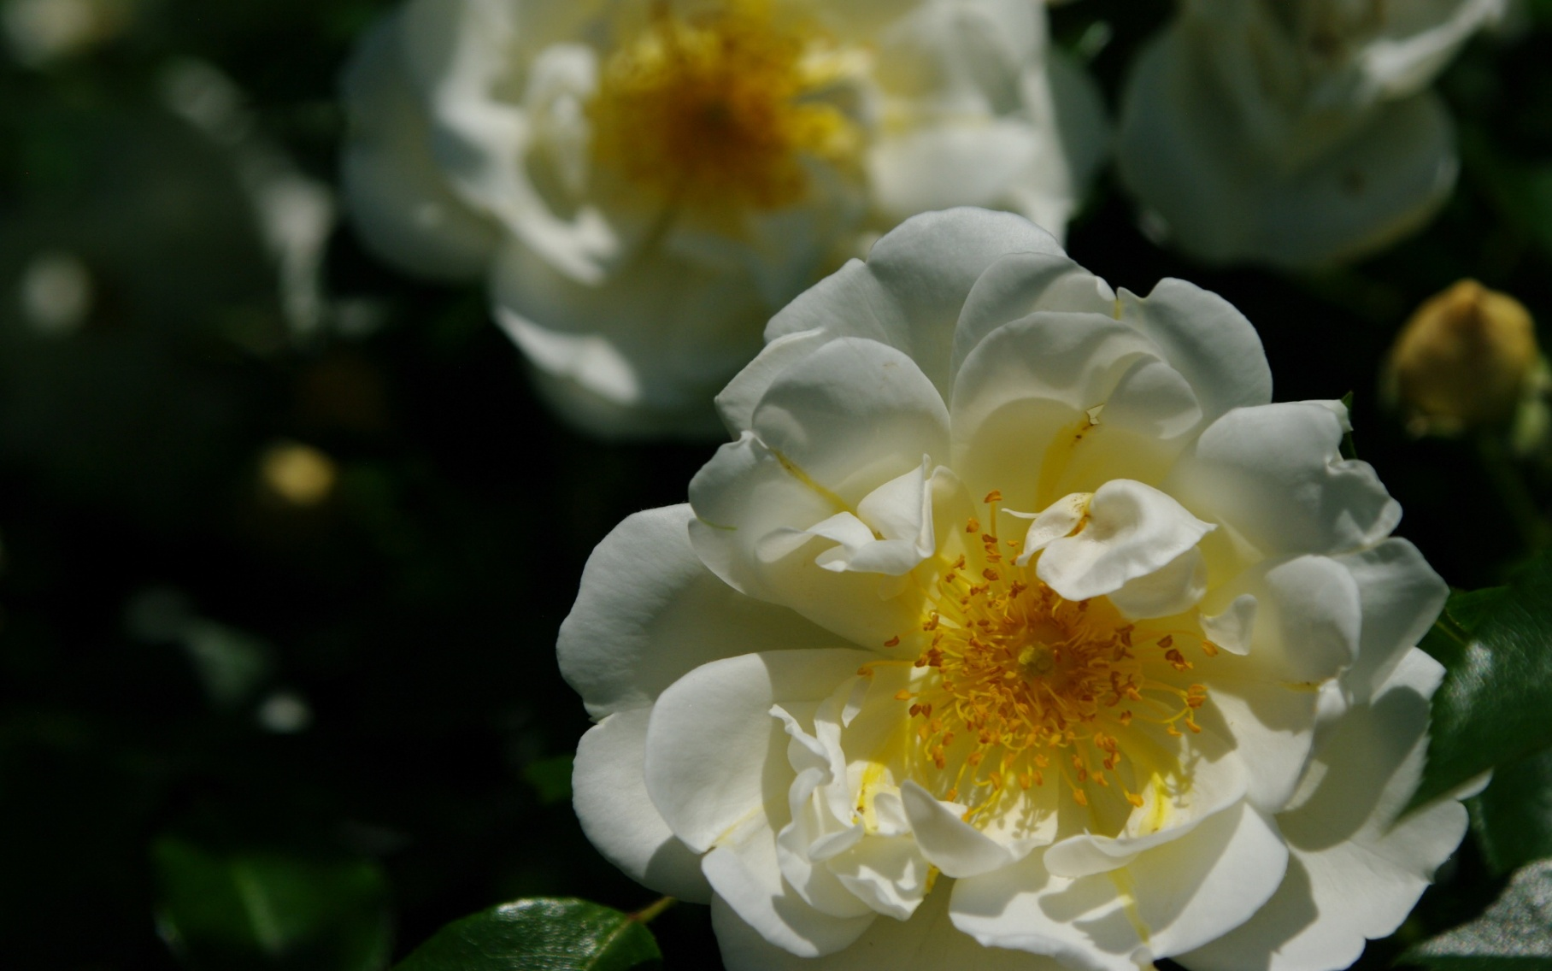
PETALOIDS

Slide 36
You can practice judging roses & teasing out their faults at home in the winter with pictures like this

Slide 37
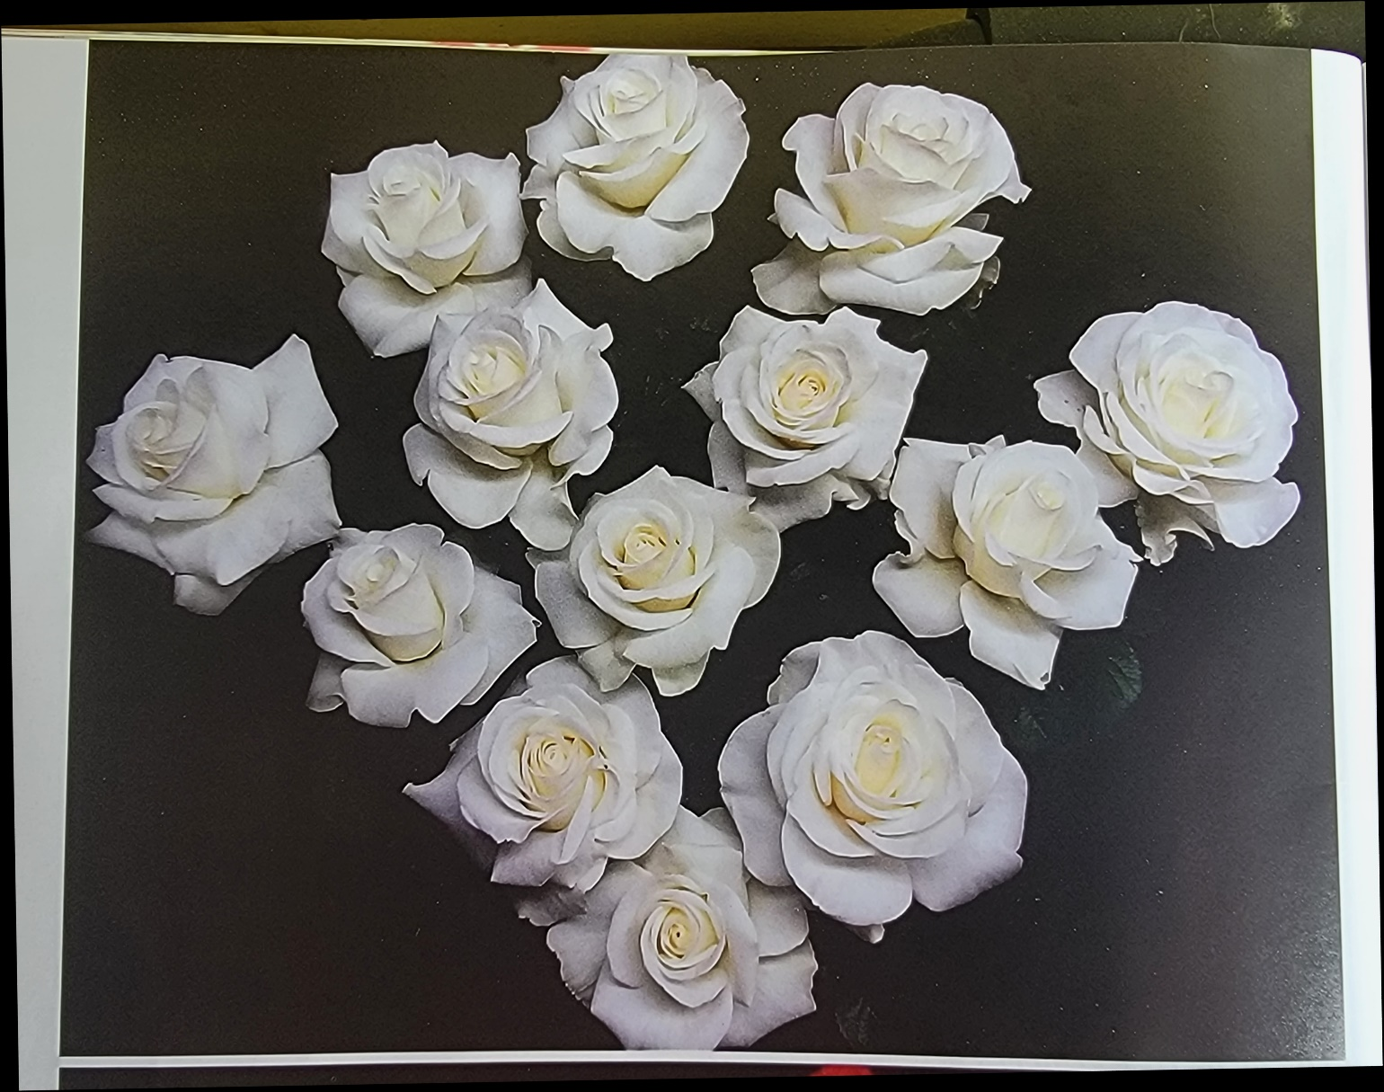
Photo from “THE AMERICAN ROSE, July/Aug., 2022 p. 23

Slide 38
They’re all beautiful !
They’re all perfect !!
No they’re not !!!

Slide 39
Look closely. See how many faults & strengths you can find in each bloom
Point Score those roses
NOW, PICK THE QUEEN etc.
WHAT ARE YOUR TOP 4, in order, & Why!
WHAT ARE YOUR BOTTOM 4, in order, & Why!

Slide 40


Slide 41
COLOR of the BLOOM 20 Pts
Judging is constant for all classes.
The actual color of the rose (red, yellow, etc.)
(Must be the TYPICAL color of the variety)
The saturation / intensity of the color. Missing or extra colors / blends = a penalty
The clearness of the color: (even or blotchy ?)
White or green petal streaks, although typical of the variety, are color faults and penalized according to the degree of the impairment.

Slide 42
COLOR – MORE CRITERIA
Penalized defects include Petals that are:
Blotched,
Spotted
Blued petals (usually from refrigeration)
Damaged petals are penalized.
A damaged petal that has been skillfully trimmed would be less penalized than if left w/all the damage.

Slide 43
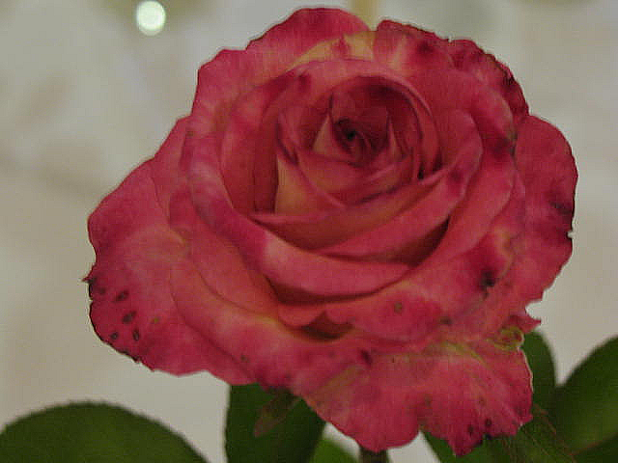
COLOR PENALTY – Blotchy

Slide 44
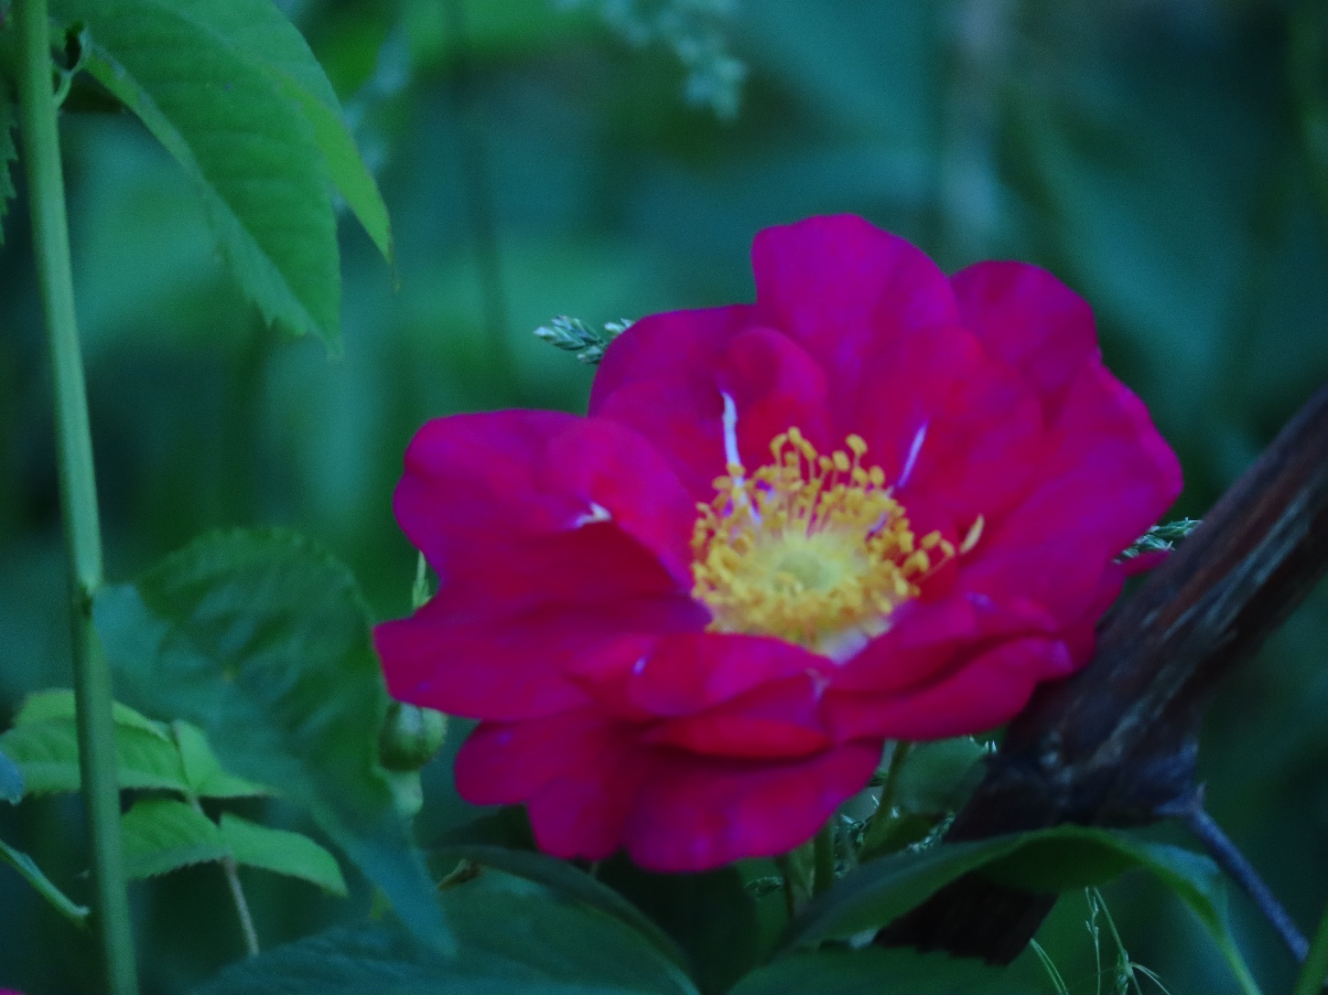
A white or green stripe, tho’ genetic, is a Color Penalty (this Bloom is Fresh)

Slide 45
SUBSTANCE of the BLOOM 15 Pts
Substance is seen in the color, texture, crispness and firmness of the petals.
Substance is an indicator of the moisture or hydration in a rose (like an inflated balloon, but with water).

Slide 46
LOSS of SUBSTANCE in Bloom
As it loses moisture, the petals become limp & droop.
The color of the bloom will change / degrade. The Petals’ shiny/satiny opalescent appearance and vibrancy will become duller.
The ultimate loss of Substance is a wilted flower.
ALSO examine substance in other parts of the specimen:
The Stamens (must be bright and fresh, when visible).
And also in its Stem & Foliage

Slide 47
SUBSTANCE in Stem & Foliage
Similarly, a specimen loses points in the Substance category when the Stem & Foliage manifest limpness, wilting, etc.
NOTE:
Specimens ALSO lose additional points in Stem & Foliage for faults in the basic structure of the Stem & Foliage, which exist regardless of Substance.

Slide 48
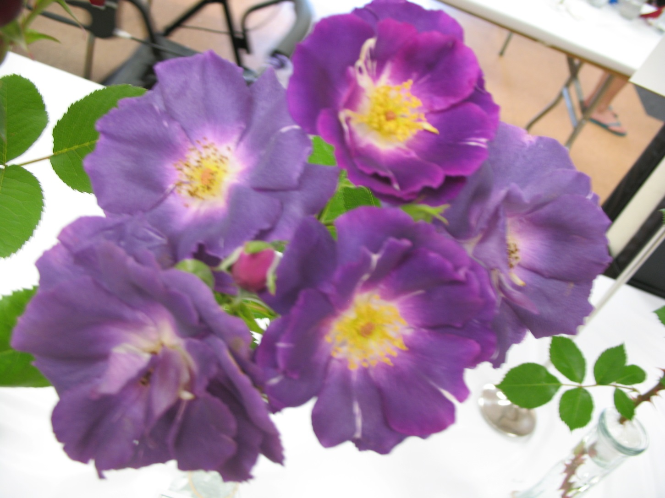
PHASES of Color, Age, Substance - 1

Slide 49
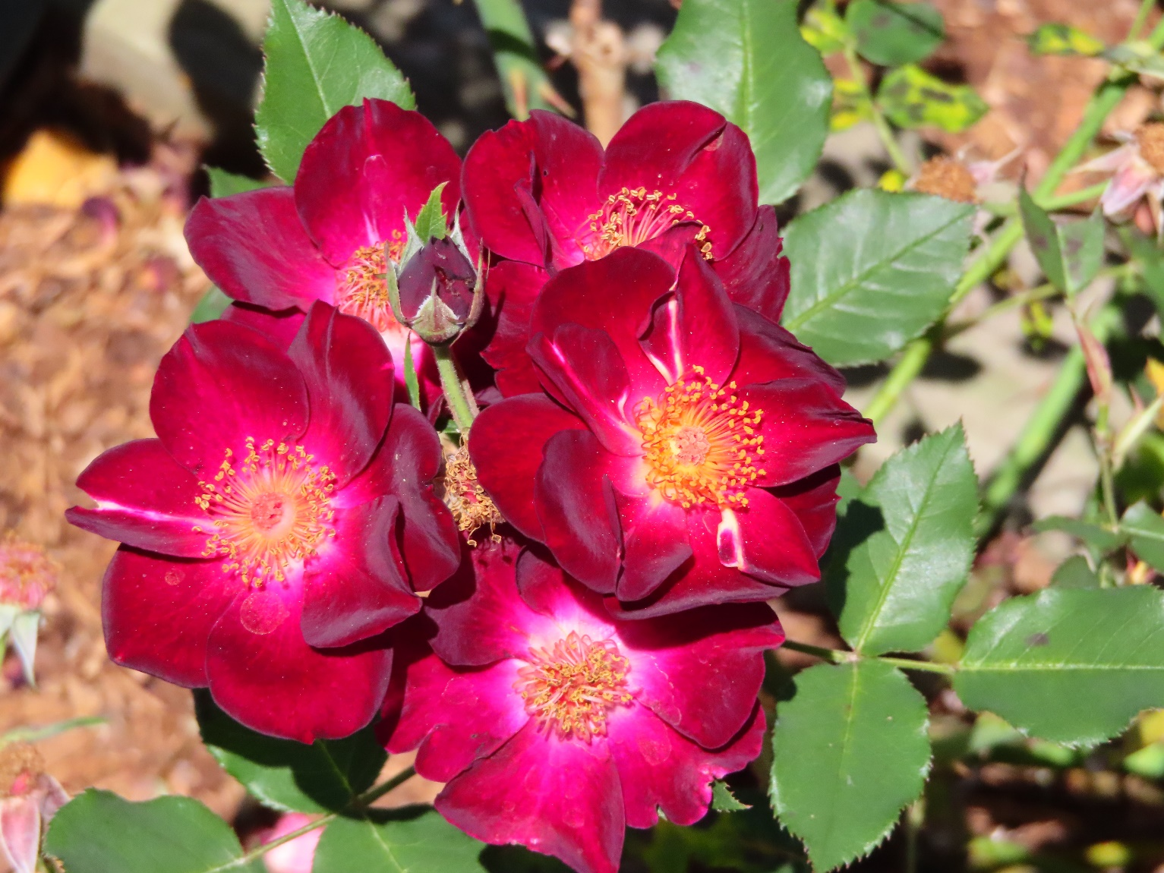
PHASES of AGE, COLOR, FRESHNESS - 2

Slide 50
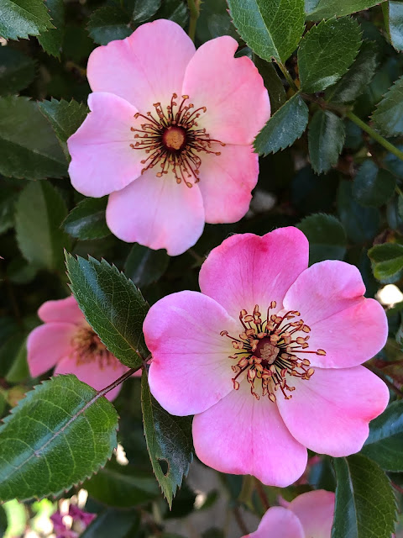
PHASES of Color Substance Freshness – 3 (Dainty Bess from Sproul Roses Blogspot)

Slide 51
PHASES # 3 cont.
In the previous slide, you could look at the top rose in isolation, & say “Oh, it’s pretty fresh,” and you wouldn’t be, uh, …”wrong.”
But, when judging, you have to remember what it looks like when it is at its very best, as in the bottom rose there. Not just “Good enough”
The overall Color and Substance (freshness), in petals, anthers, & filaments, are much better in the bottom rose.
We have to juggle such objective truths with the level of the show, etc.

Slide 52
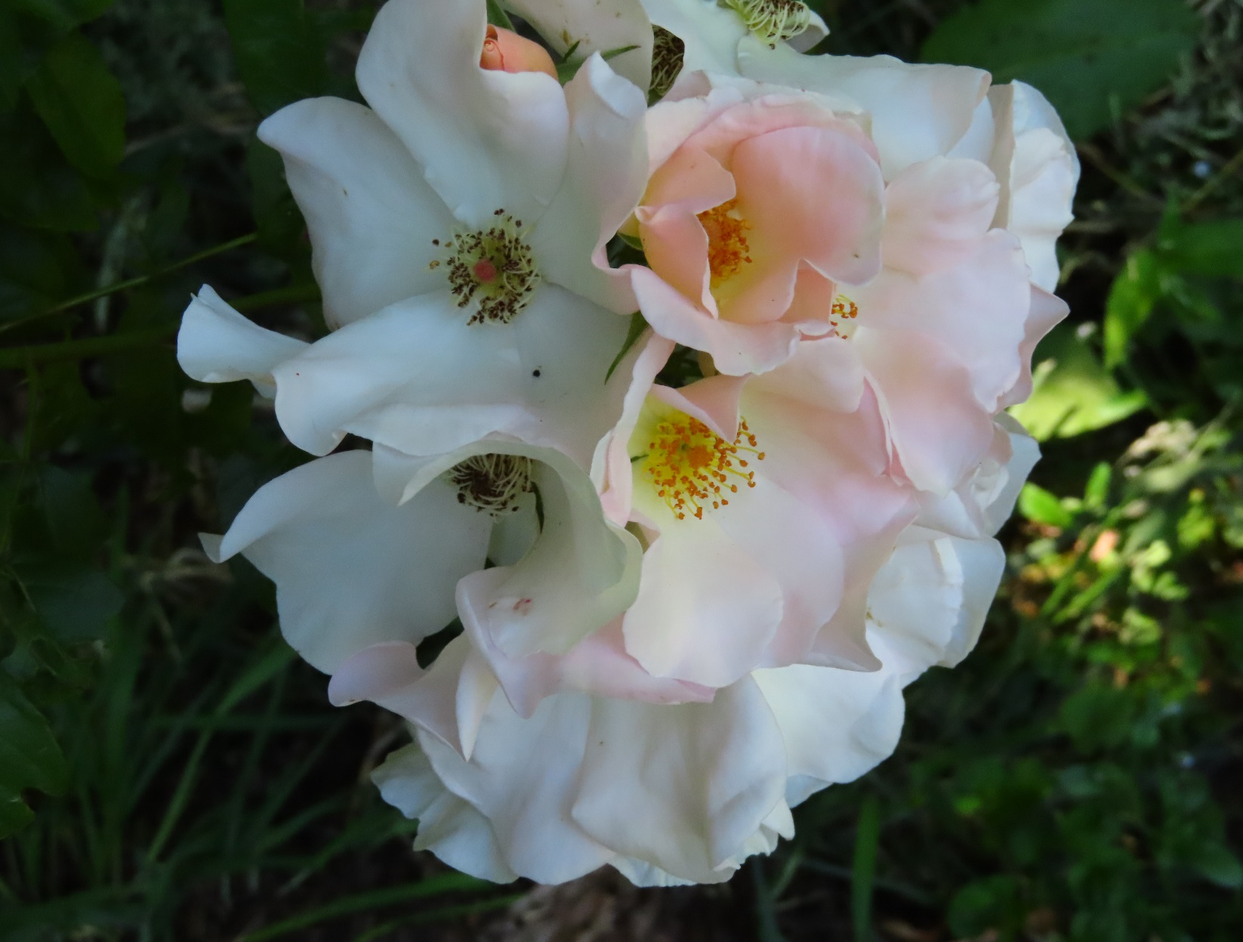
PHASES of AGE, COLOR, FRESHNESS - 4

Slide 53
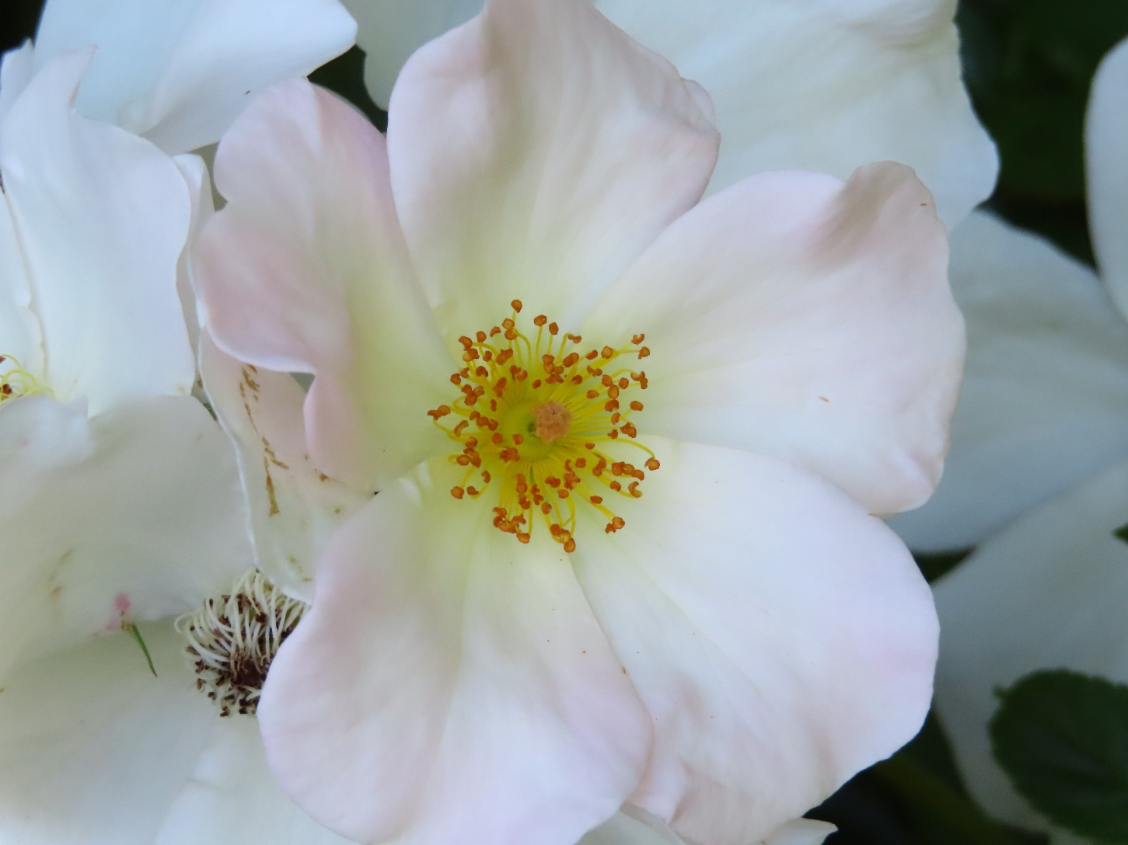
FRESH STAMENS, PISTIL, & PETALS

Slide 54
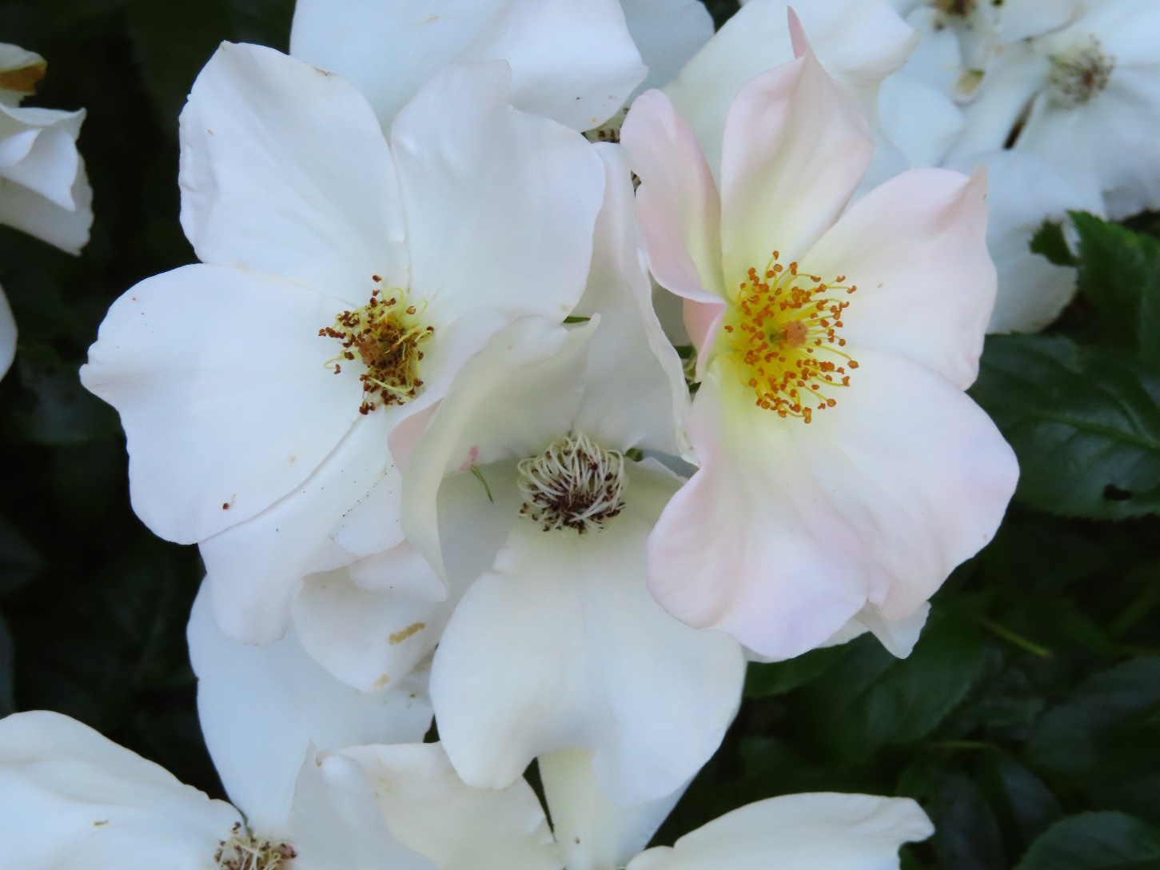
COMPARE FRESH & NOT-FRESH

Slide 55
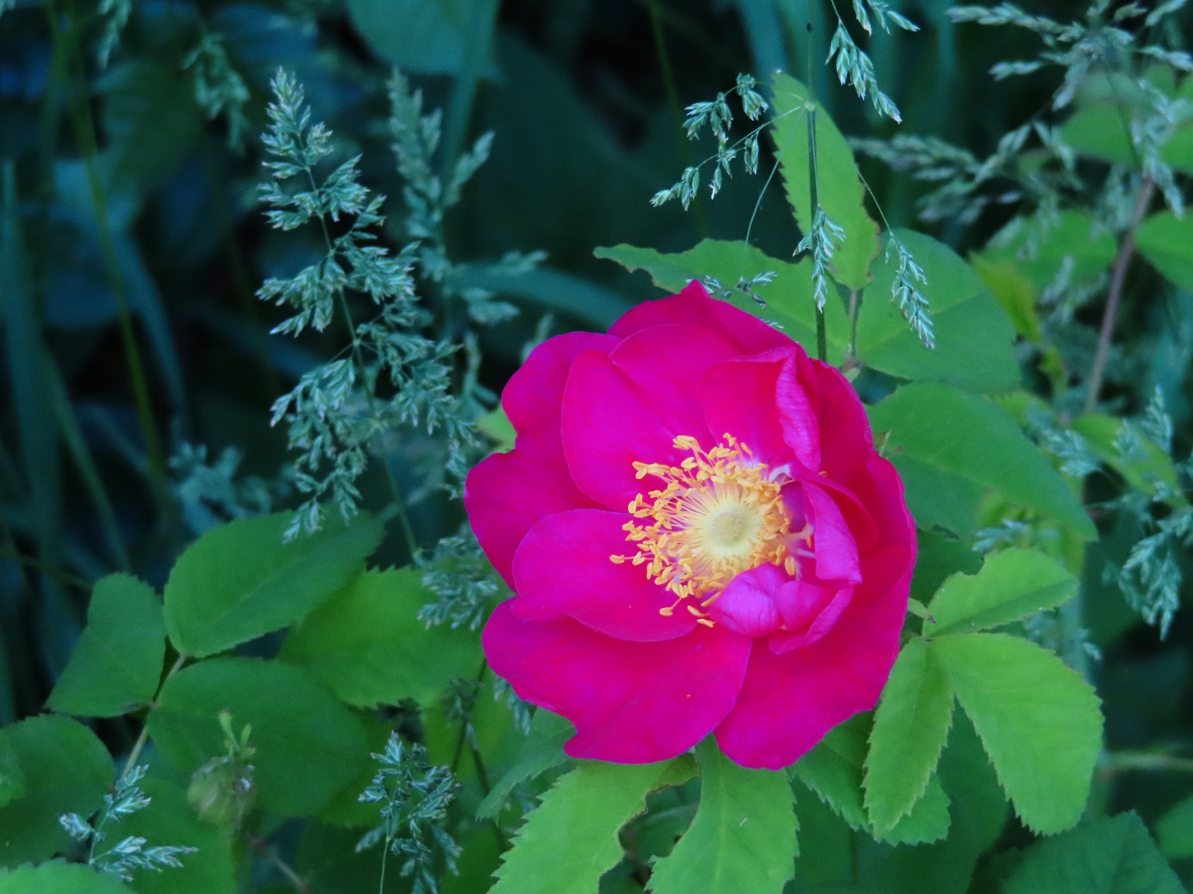
ALIKA - Fresh

Slide 56
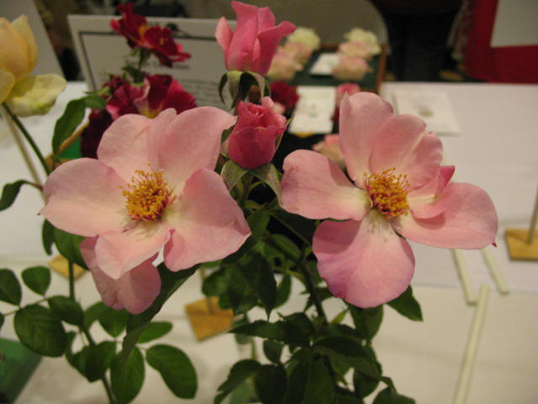
Photo of good substance freshness

Slide 57
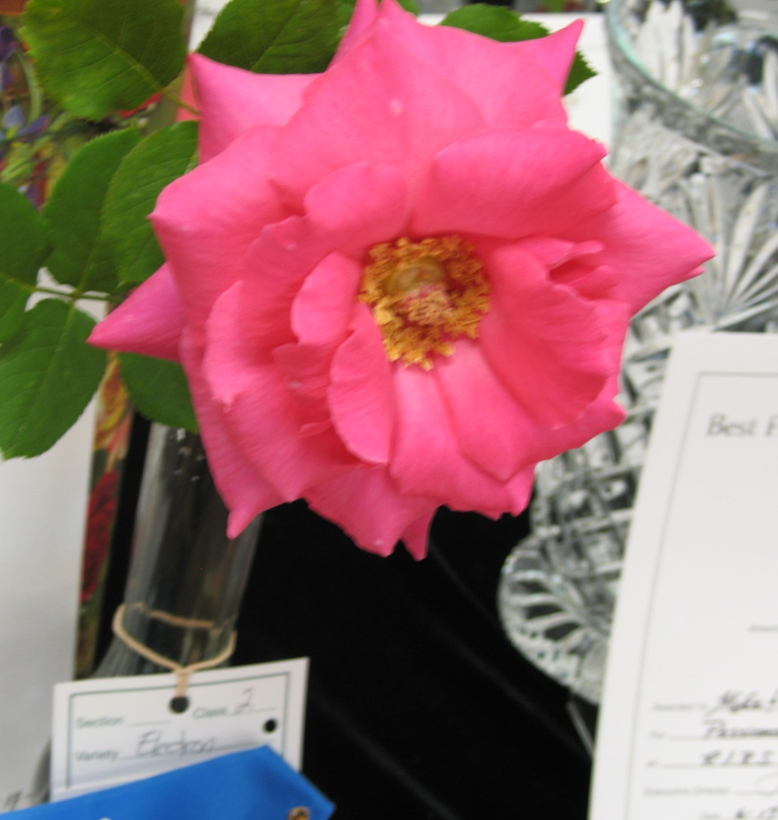
GOOD SUBSTANCE

Slide 58
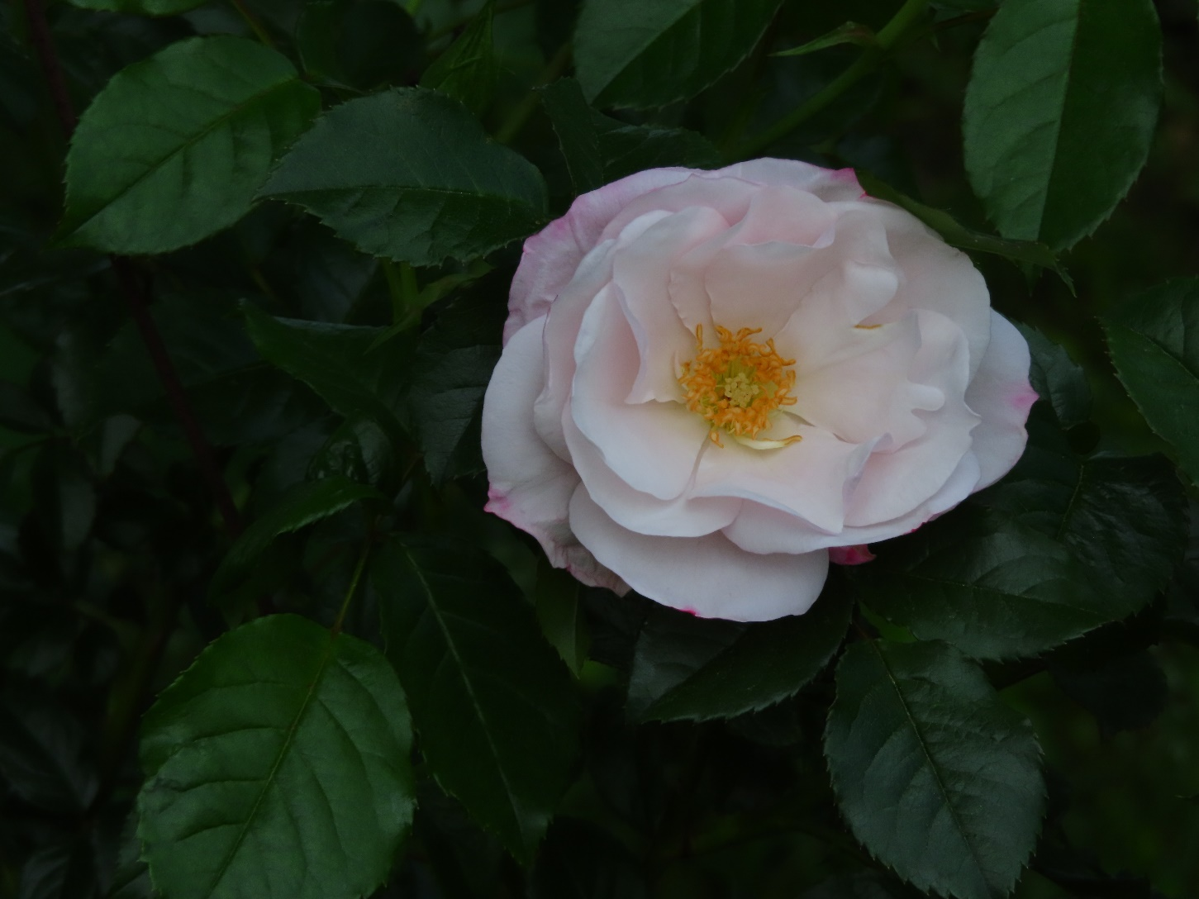
SOME HAVE SHORT STAMENS

Slide 59
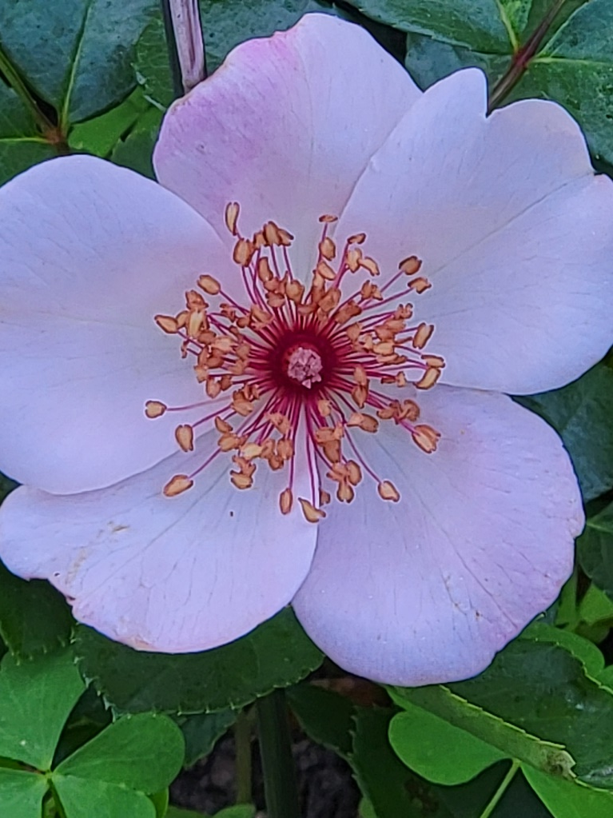
Not All Stamens & Anthers Are Yellow
The Charlatan - Fresh

Slide 60
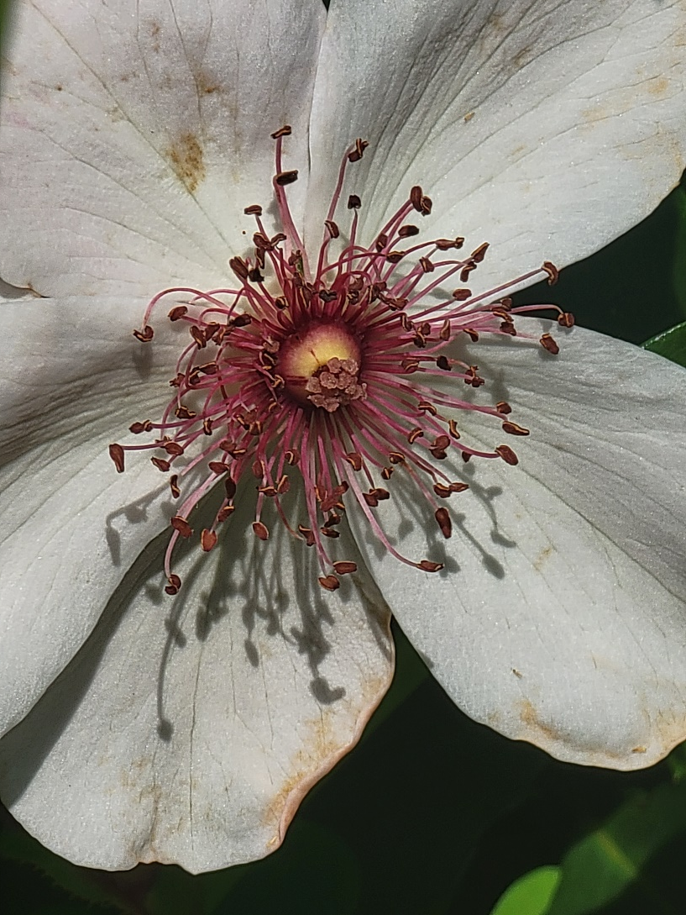
THE CHARLATAN S. (not so fresh)

Slide 61
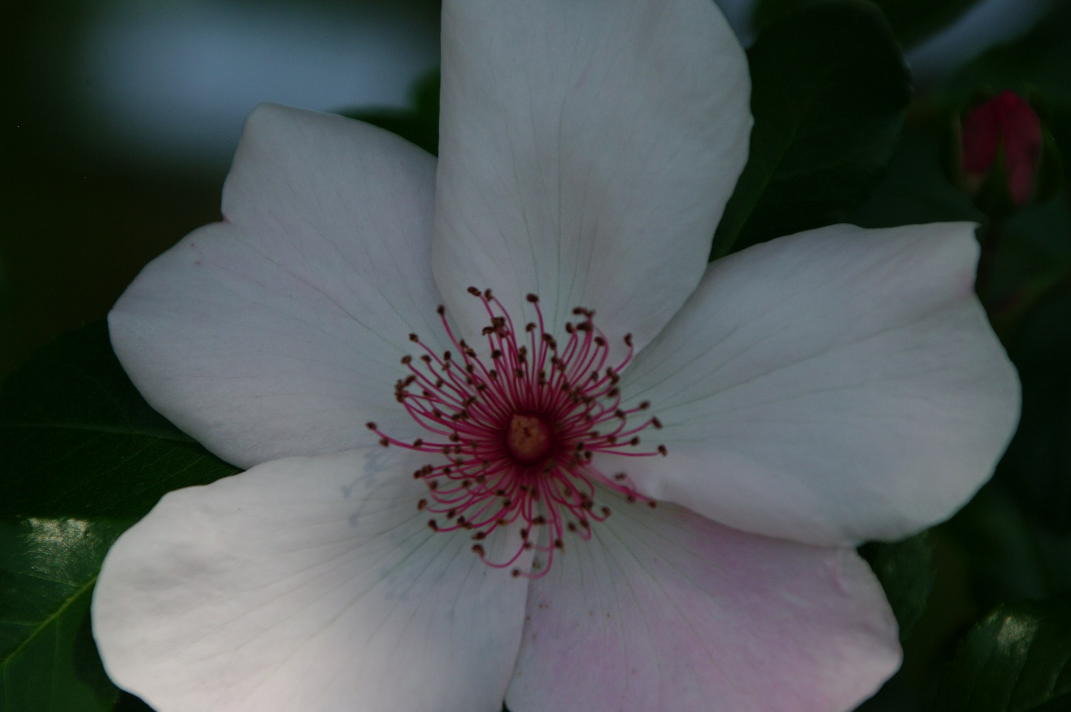
Not All Stamens Are Golden

Slide 62
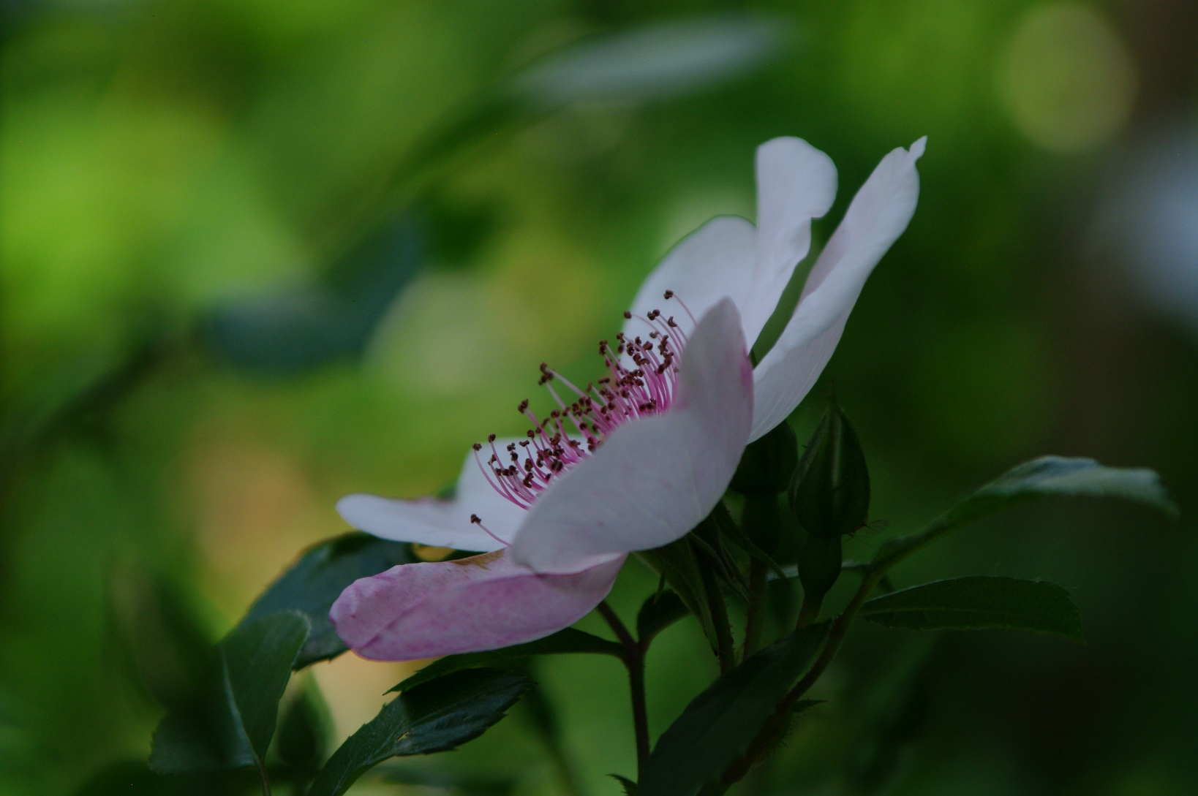
Stamens Typical of this variety - 2

Slide 63
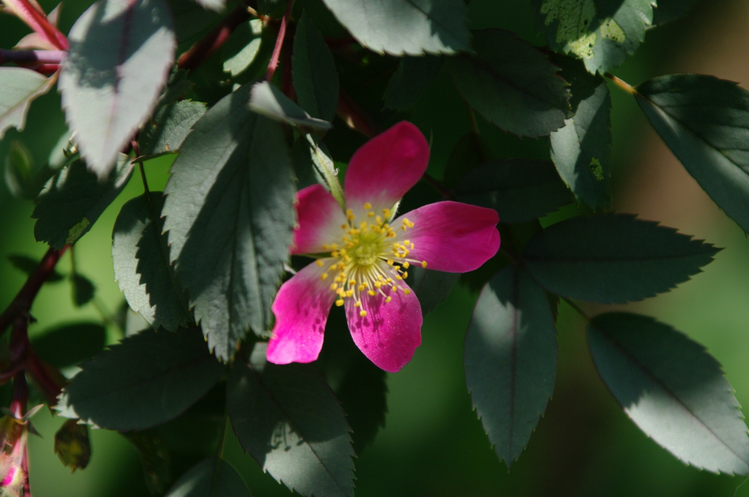
VERY FRESH – ROSA GLAUCA

Slide 64
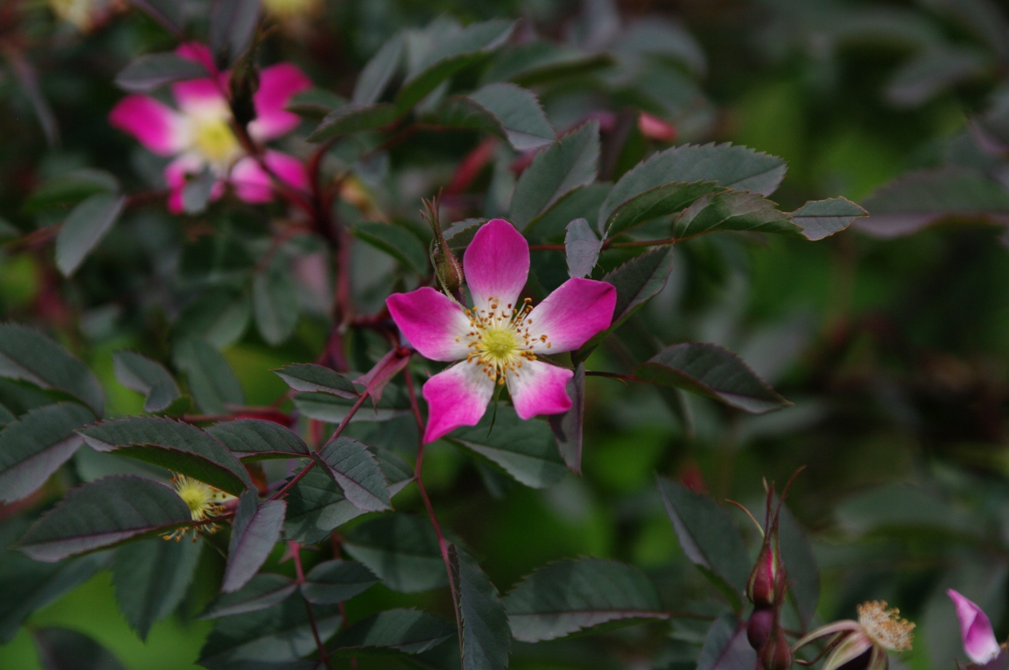
LESS FRESH

Slide 65
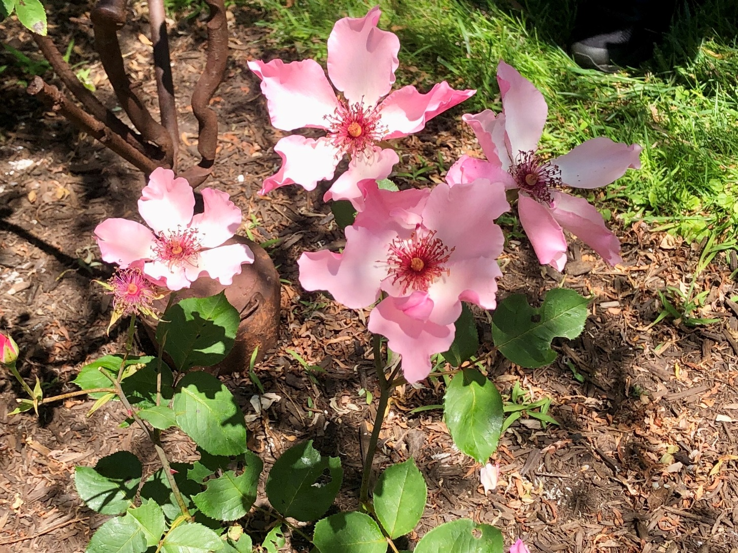
DAINTY BESS HT

Slide 66
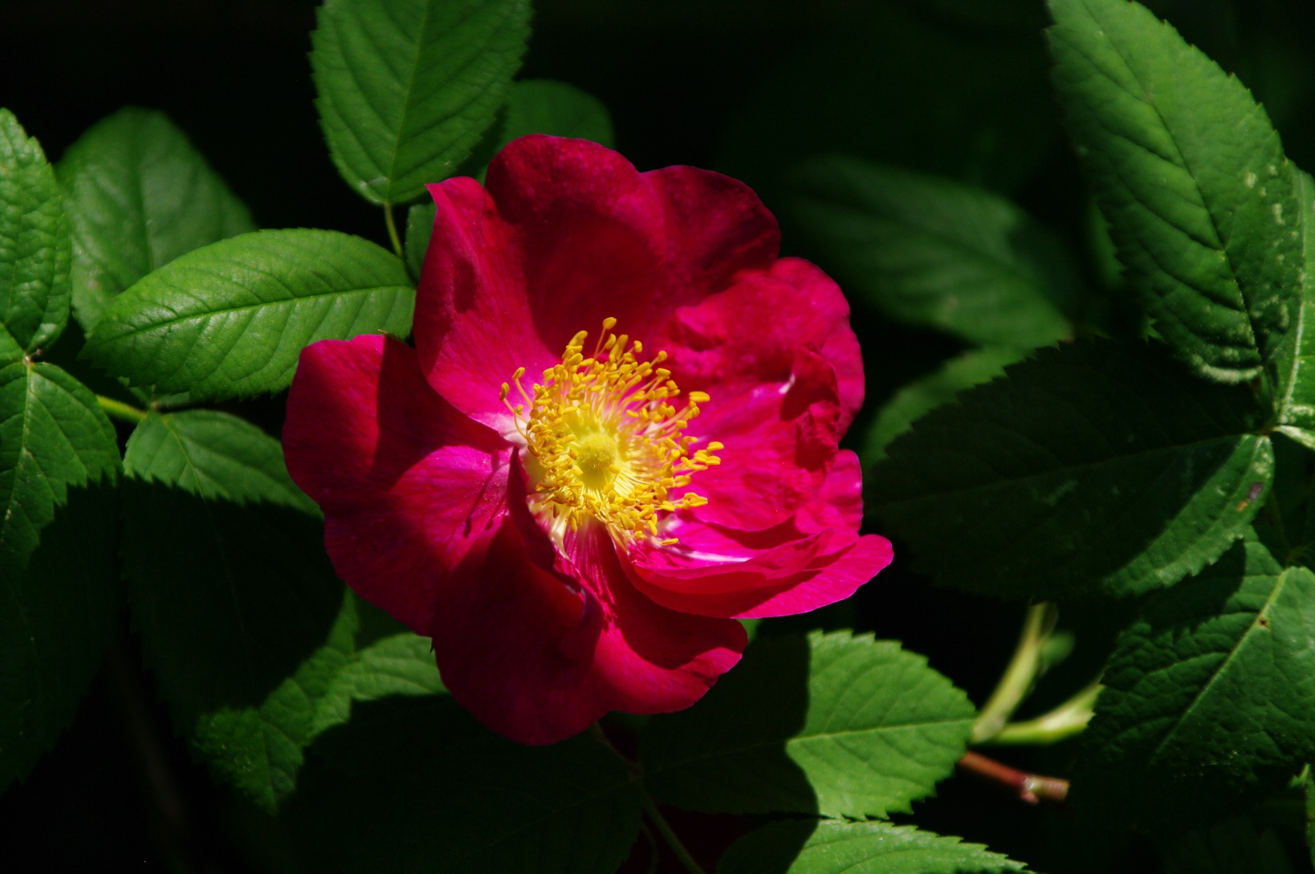
FRESHER - ALIKA

Slide 67
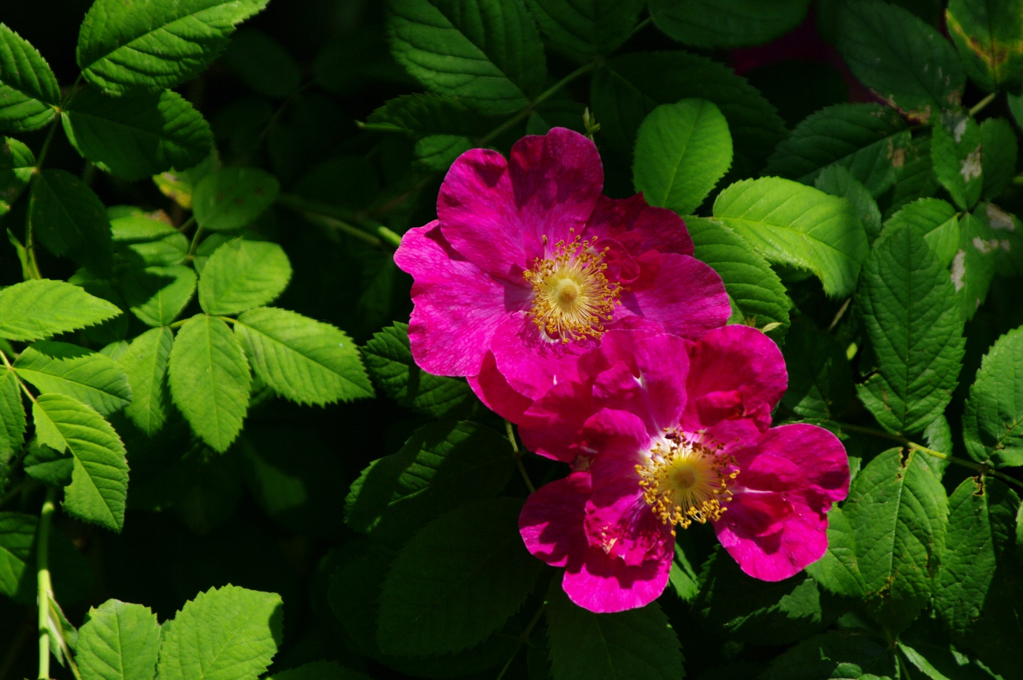
NOT AS FRESH - ALIKA

Slide 68
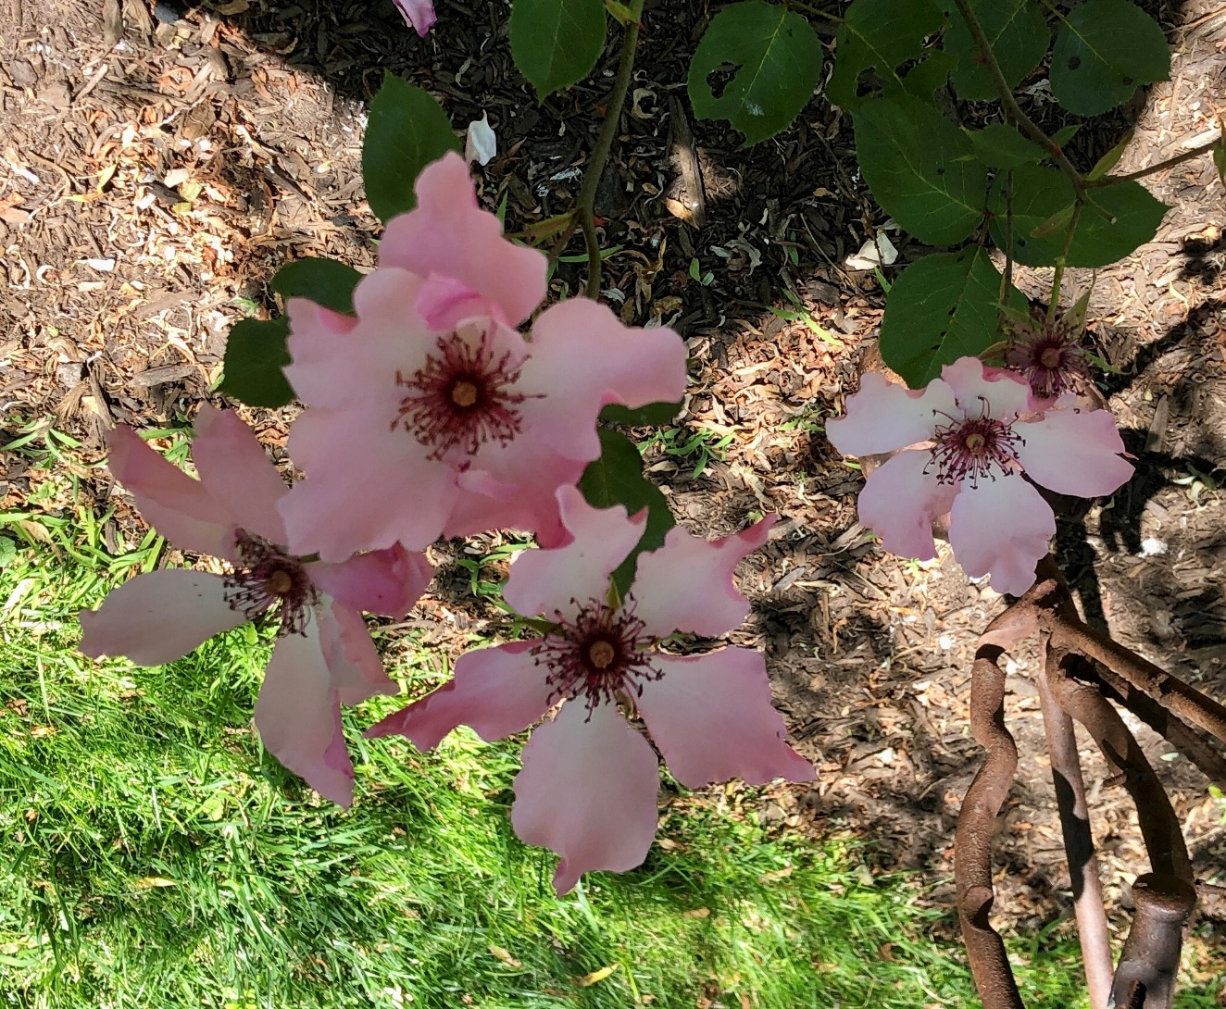
DAINTY BESS

Slide 69
STEM and FOLIAGE # 1 20 Pts
The stem serves to support the bloom.
The foliage acts as a natural frame for the enhancement of the bloom.
Any deviation from these objectives of stem and foliage is cause for some penalization.

Slide 70
STEM and FOLIAGE - 2
The stem should be straight, intact with thorns, and support the bloom and foliage well.
The foliage must be clean, healthy, undamaged.
It should frame the bloom from both over-head and from the side. Ideally, it should have 4 leaves on the stem, 90 degrees apart, giving the bloom a full background (a “frame”) of good foliage when seen from overhead, & from the side.
Symmetry & minimal gaps are preferred.

Slide 71
STEM and FOLIAGE - 3
Ideally, it should look like a bloom rising out of a rain forest.
Some varieties’ growth habits produce stems that are crooked, or overly thin/weak, thick, long, short, etc.
Although sometimes typical of the variety, such a stem is considered a fault, subject to penalization.
Look for an eye-pleasing specimen of that variety.

Slide 72
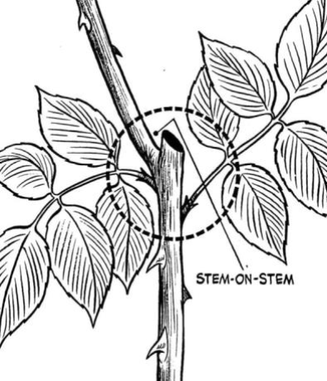
STEM and FOLIAGE - 4
Stem-on-stem above the lip MAY be a penalty

Slide 73

Side growth MAY be a penalty.

Slide 74
STEM and FOLIAGE - 5
Dis-budding stubs and black scars at the disbudding site can detract from the specimen and are a fault in Stem & Foliage.
Leaving or removing side-buds may cause a penalty.
It is a judgement call for the exhibitor to decide if dis-budding might cause a more distracting penalty.

Slide 75
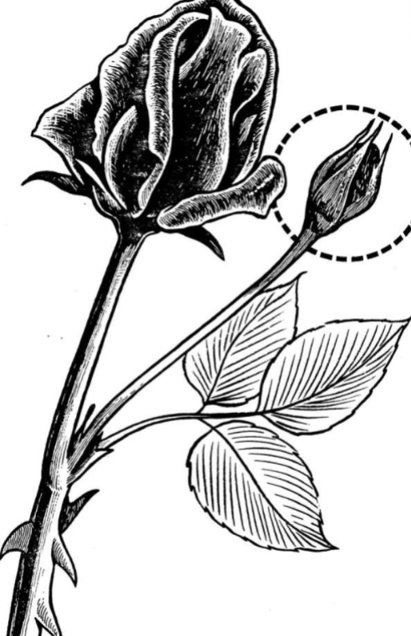
Not dis-budded penalties vary

Slide 76


Slide 77
Prickles (thorns) removed from the stem above the rim of the rose vase will incur a penalty because,
for most varieties, a stem without prickles is not typical of the variety.
As always, IGNORE whatever is below the lip of the vase.

Slide 78
BALANCE and PROPORTION 10 Pts
Do the sizes of
its bloom,
its stem and its foliage form a pleasing whole?
A huge bloom on a short, thin stem or,
a tiny flower atop very long, thick stem
present an unpleasing appearance.
And, so, a PENALTY, BY DEGREE OF DISTRACTION.
One “rule of thumb” is that, for “HT exhibition form” blooms, the stem length should be approximately six times the height of the bloom. This holds true both for large roses and for minifloras and miniatures. BUT, NOT for Shrubs, OGR, Climbers, etc.

Slide 79
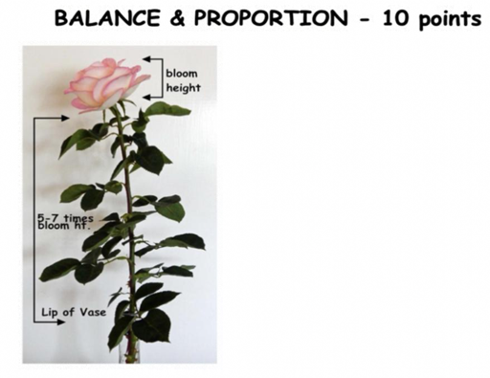

Slide 80
SIZE of the BLOOM – 1 10 Pts
Size refers to the actual dimensions of the bloom.
In MOST classes, a good larger bloom would score better than a good smaller bloom of the same variety.
However, for Miniatures & M-Fl’s the size of the bloom is should be typical of the variety.
Bigger or Smaller is now penalized !!

Slide 81
SIZE of the BLOOM - 2
When all other factors are equal, a good larger bloom prevails over a good smaller bloom of the same variety. (Except Mini’s & MFl’s)
Likewise, the larger bloom of a normally smaller-bloom variety will take precedence over a smaller bloom of a normally larger-bloom variety.
Except Mini’s & M-Fl’s where typical “Rules.”

Slide 82
SIZE of the BLOOM - 3
Size by itself should not sway a judge
When judging a challenge class, or for a court of honor, the judge should not favor VARIETIES that produce larger blooms over varieties that produce smaller blooms merely because they naturally produce larger blooms.
The size of each bloom must be compared to the size that is typical of that variety ( & not to the size of the other entries under consideration.

Slide 83
A COLLECTION that is not a Challenge class should only be
JUDGED ON HORTICULTURAL EXCELLENCE ALONE.
A COLLECTION’s point score is the sum of its parts. Period.
Each bloom counts equally, & Is judged individually.
A collection usually does not get additional “artistic” points for presentation.
NOTE Any points for Overall Appearance will also depend on the requirements of the class, in the Show’s schedule.
It is often necessary to judge specimens of different types of roses, different stages, and/or different flower forms against each other. Sprays may also be permitted in some classes. Use Horticultural judging only.
With all Challenge & Collections Classes,
carefully READ THE CLASS DESCRIPTION prior to judging the class.
GUIDELINES Chapter 14 has lots more info.
BLOOM-ONLY SPECIMENS ie Rose in a Bowl, etc. get no points for stem etc ; )

Slide 84
NEW CLASSES FOR DECORATIVE ROSES
There are many different “Forms” that a rose bloom can display:
The Classic Hybrid Tea spiraled “Exhibition Form,” Singles, the assorted OGR & Austin Rose forms: cupped, quartered, buttoned, etc. etc.
Many ARS classes (Floribundas, Shrubs, OGR, etc.) contain varieties that display many different forms. Those Classes judge varieties of different forms all-together in the same class, without giving any preference to one form over another.

Slide 85
But, in the history of the ARS, 3 classes
( HT’s & GFL’s, Mini’s, & MFL’s )
have been very much dominated by varieties that produce blooms of the Classic HT High-Spiraled “Exhibition Form.”

Slide 86
Those 3 Classes have historically only allowed their varieties which display the Exhibition Form to compete for Queen & Court.
Their Non-Exhibition Form varieties were told they had to settle for only getting a Blue Ribbon, & go home.

Slide 87
With the advent of the hardy Canadian Roses, and
especially with the advent of Austin’s “English Roses,” and
with their enthusiastic acceptance by the public, and
with other breeders following suit,
the 3 “Exhibition Form” Classes became flooded with very popular varieties that do not display the HT Exhibition Form.

Slide 88
This has led to increasing discontent among members whose beloved, beautiful, hardy roses were refused admission to the Courts of their classes (AS THEY WOULD HAVE BEEN IN THE OTHER ARS CLASSES ! ).
Instead, they are told to settle for a Blue ribbon & go home, regardless of how much more beautiful & healthy their rose MIGHT have been than their Exhibition Form relatives up on the Court.

Slide 89
The addition of the Decorative Classes among the HT’s & GFL’s, Mini’s & MFL’s was intended to address this discontent, & apparent injustice.
These new Classes provide a way for their non-Exhibition Form varieties to receive a modicum of recognition as the “BEST” Decorative HT / GFL, or Mini, or MFL.

Slide 90
IMPORTANT: Decorative varieties are to be displayed at their ideal exhibition stage.
Varieties that CAN display the HT Exhibition Form ARE NOT “Decorative” roses.
They may NOT be entered into a Class for “Decorative” roses. (ie NO Open Bloom Geminis, Moonstones here).
Varieties that can display the HT Exhibition Form are restricted to their Court and to their Open Bloom Classes.

Slide 91
SHRUB CLASSES HAVE BEEN CHANGED
Previously, there were 2 Classes of Shrubs: “Classic Shrubs” and “Modern Shrubs”
In 2021, the ARS divided “Modern Shrubs” into three sub-Classifications:
English-Style (antique-style) (Eng)
Ground Cover (Gc)
Landscape Shrubs (S)

Slide 92
The English-Style (antique-style) group is pretty self- explanatory.
So is the Ground Cover (Gc) group.
The Landscape Shrubs (S) would have been more correctly named “The Catch-All Group.”
It “includes all other shrubs that do not fit into the two previous classifications.
Landscape shrubs are typically free flowering roses with single, semi-double or double blooms.
The classification also includes varieties that are winter hardy and suitable for northern landscape applications”
(ie Canadian & Buck roses).

Slide 93
Unfortunately this was poorly timed:
ARS finances & membership were decreasing,
modernizing the ARS website was going slowly & expensively,
computerizing Modern Roses was very slow & difficult,
getting the Shrub changes reflected in Modern Roses was also slow, etc., etc.
- staffing was turning over, & institutional knowledge was being lost.

Slide 94
Initially, there was a delay in implementing these changes, due to finances.
Fortunately, things are now pretty well straightened out at ARS & in the Handbook for Buying Roses.
So. You should be able to implement the Shrub changes.

Slide 95
However, it has been my experience that some Societies have come to prefer to make up their own Shrub Classes.
(ie lump Landscape & Ground-Cover shrubs into one class).

Slide 96
They can do that.
BUT IF they do,
THEN they cannot give ARS awards.
They can only give Local Rose Society award certificates.

Slide 97
The ARS does offer 4 options for awarding ARS Certificates to SHRUBS
A single BEST Cert that covers all classes
2. One BEST Cert for Classic Shrubs, and one for Modern Shrubs,
But, the BEST Modern would have to be selected from among ALL three of the new Modern sub-groups.
Queen, King, & Princess Certs from among ALL 3 of the Modern sub-groups
4. A combination of # 2 and # 3 above.

